Slide 1
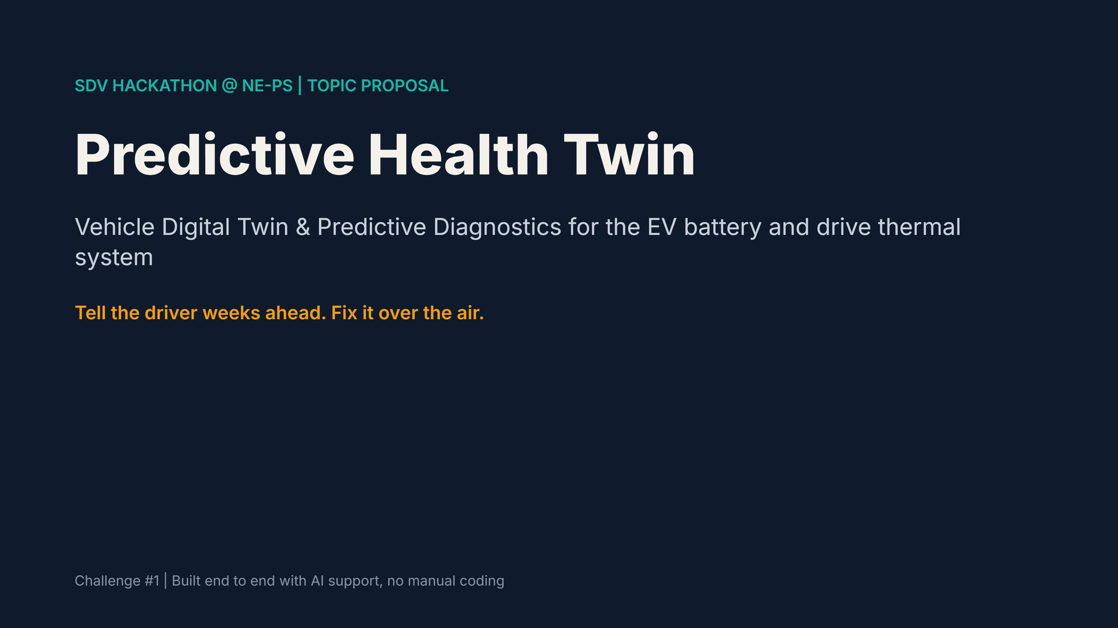
Notes:
Open by saying we are proposing Challenge 1 and why it is the safest, strongest pick.

Slide 2
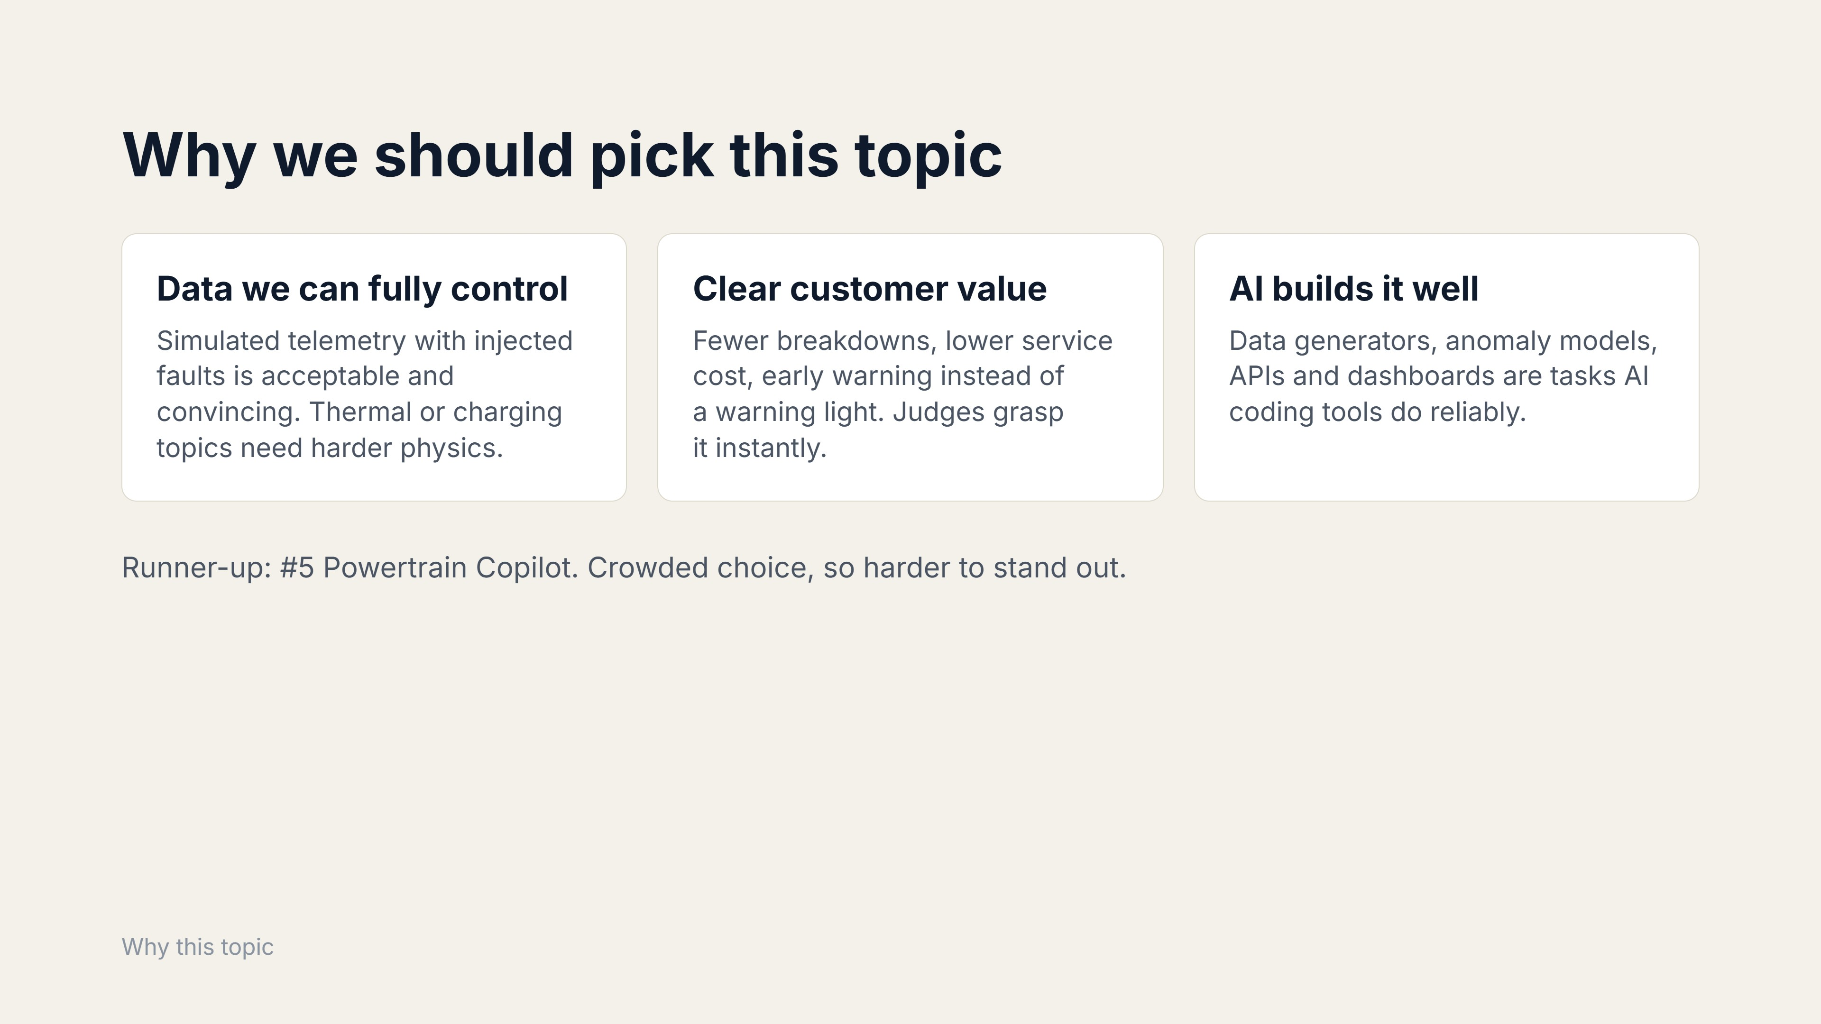
Notes:
Compare against the other four challenges briefly.

Slide 3
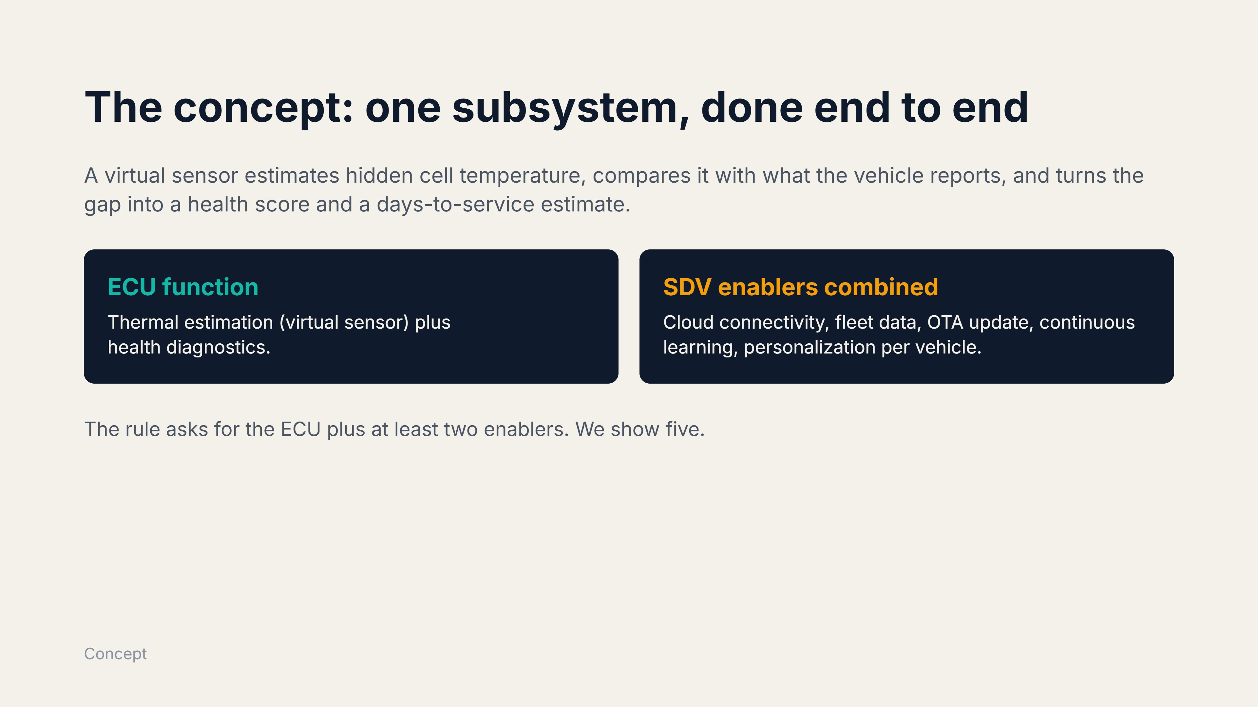
Notes:
Narrow scope on purpose: a small thing that works beats a broad thing that half works.

Slide 4
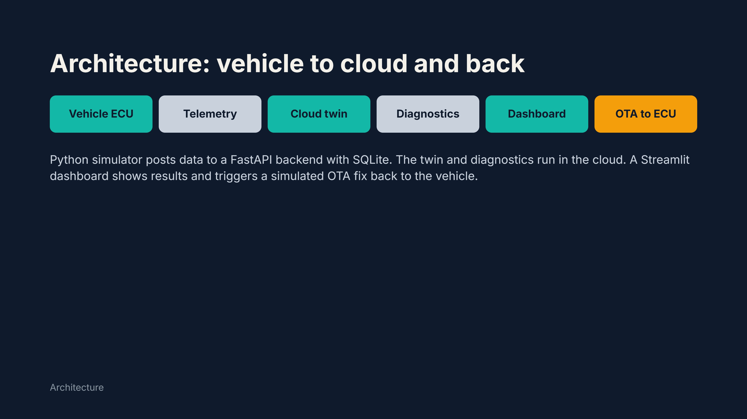
Notes:
Walk left to right, then point at the OTA loop closing back to the vehicle.

Slide 5
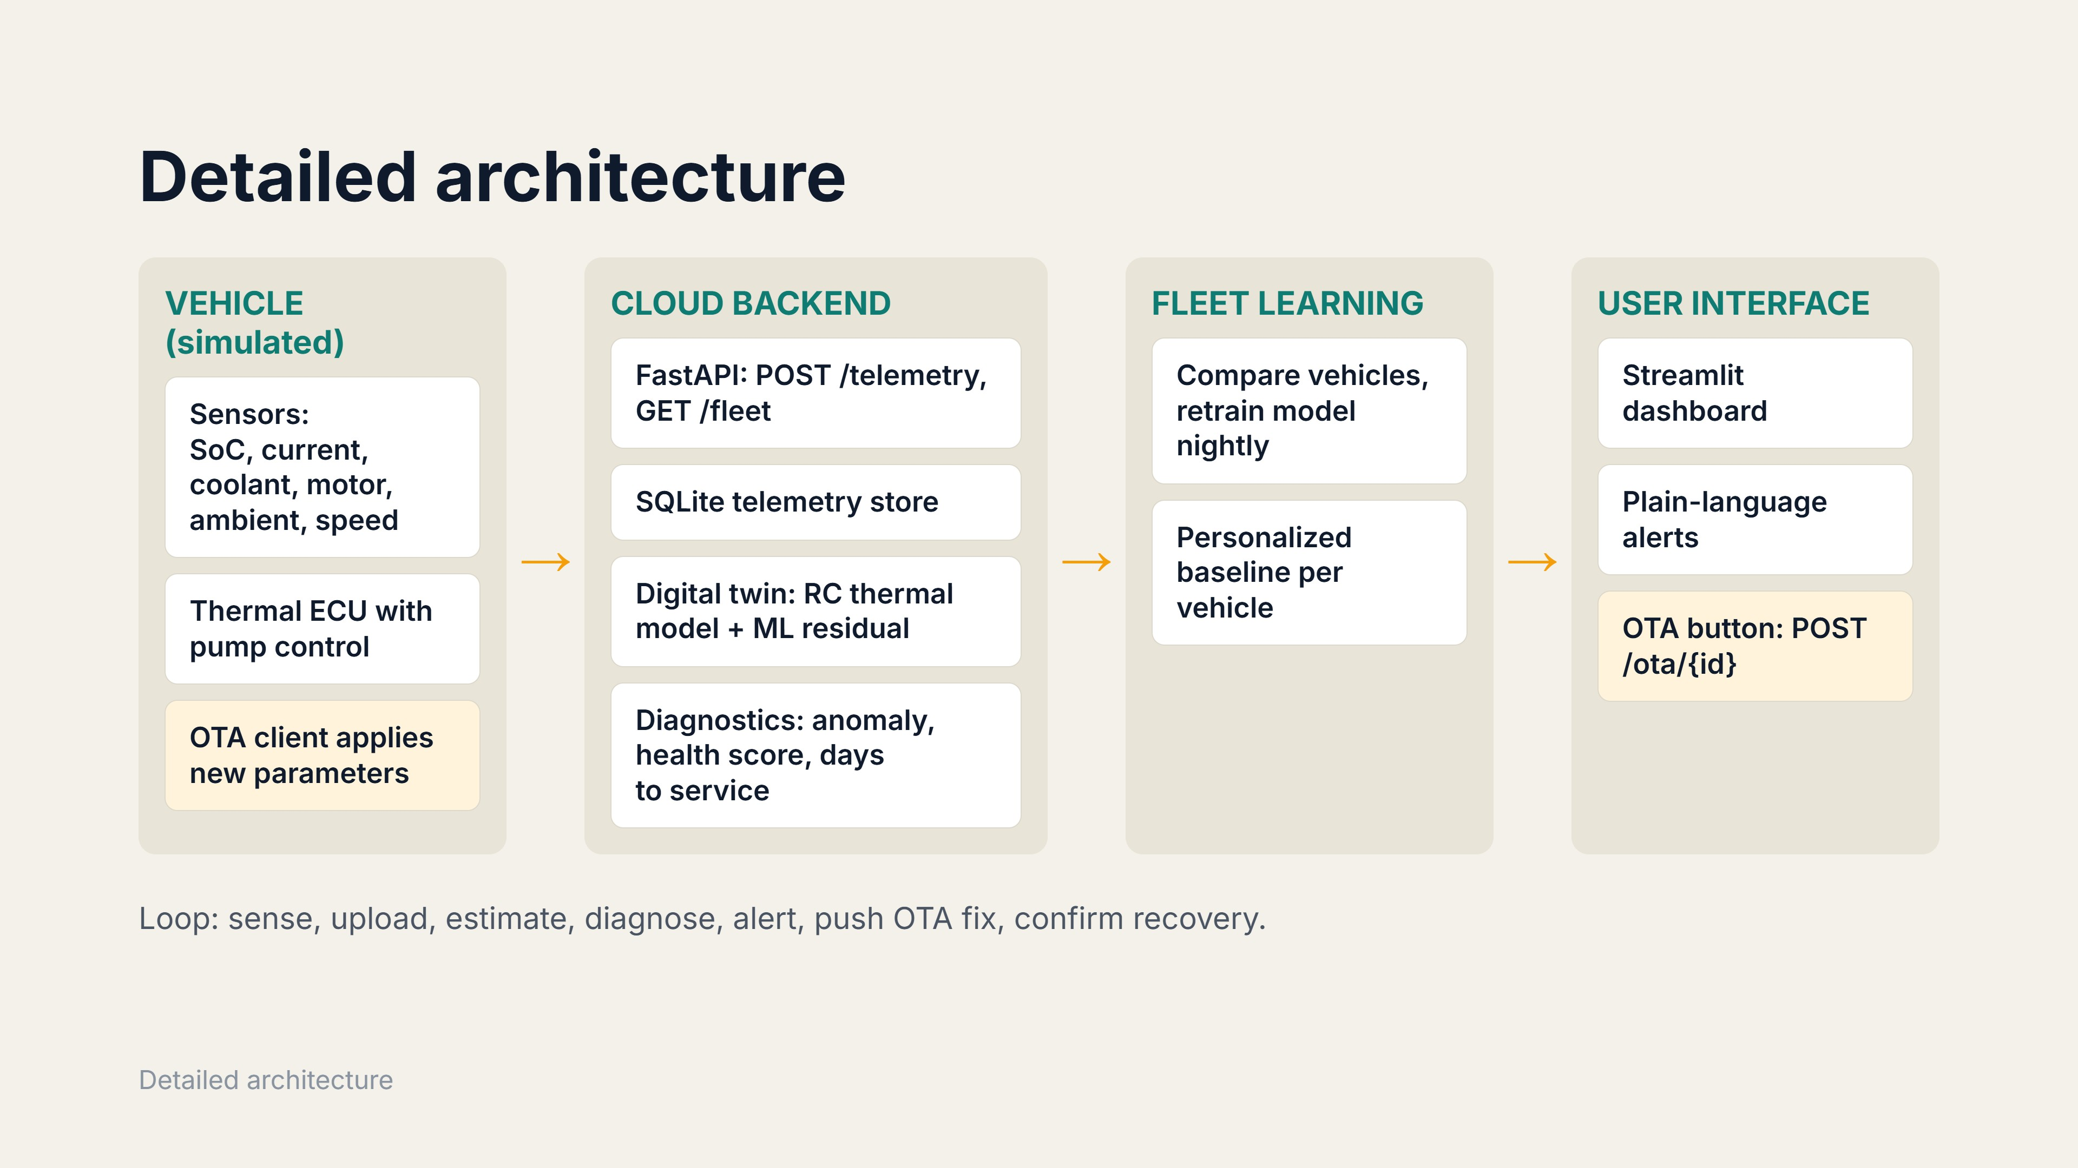
Notes:
Orange boxes mark the OTA path back to the vehicle.

Slide 6
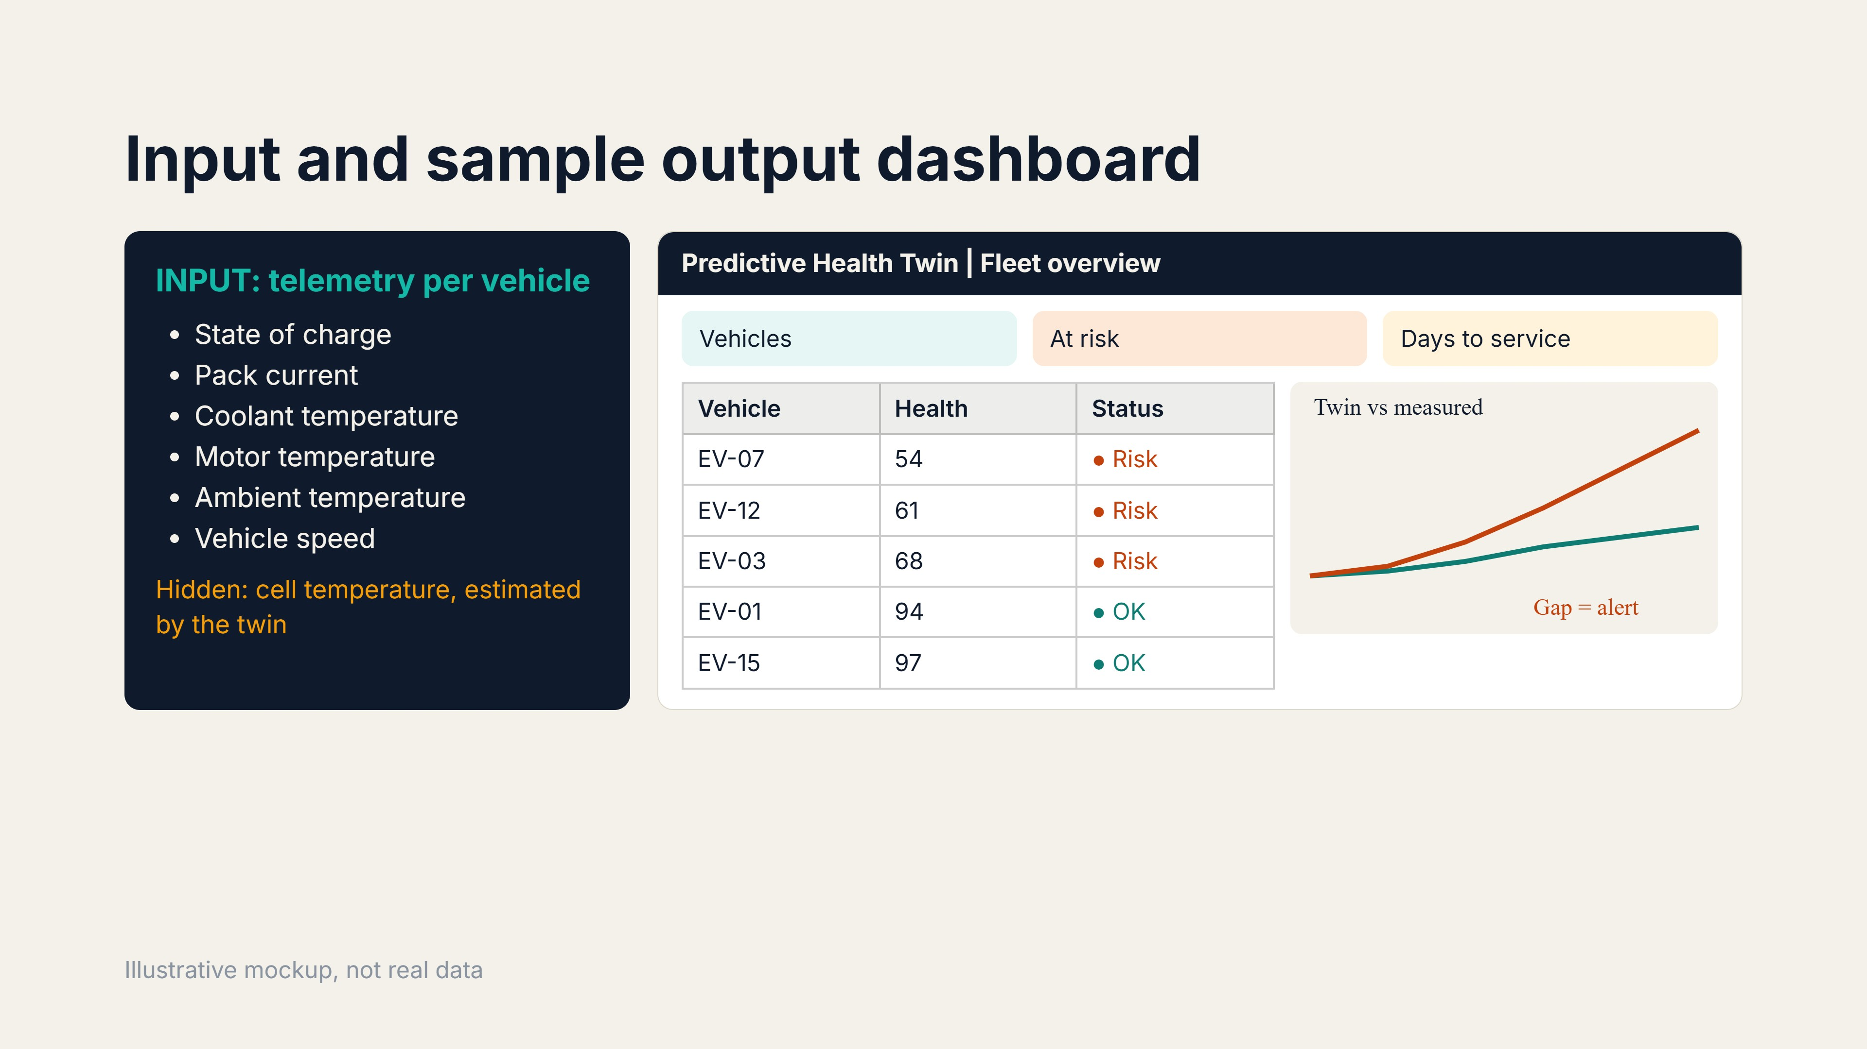
Notes:
The right side is a mockup of the planned Streamlit dashboard. Values are placeholders.

Slide 7
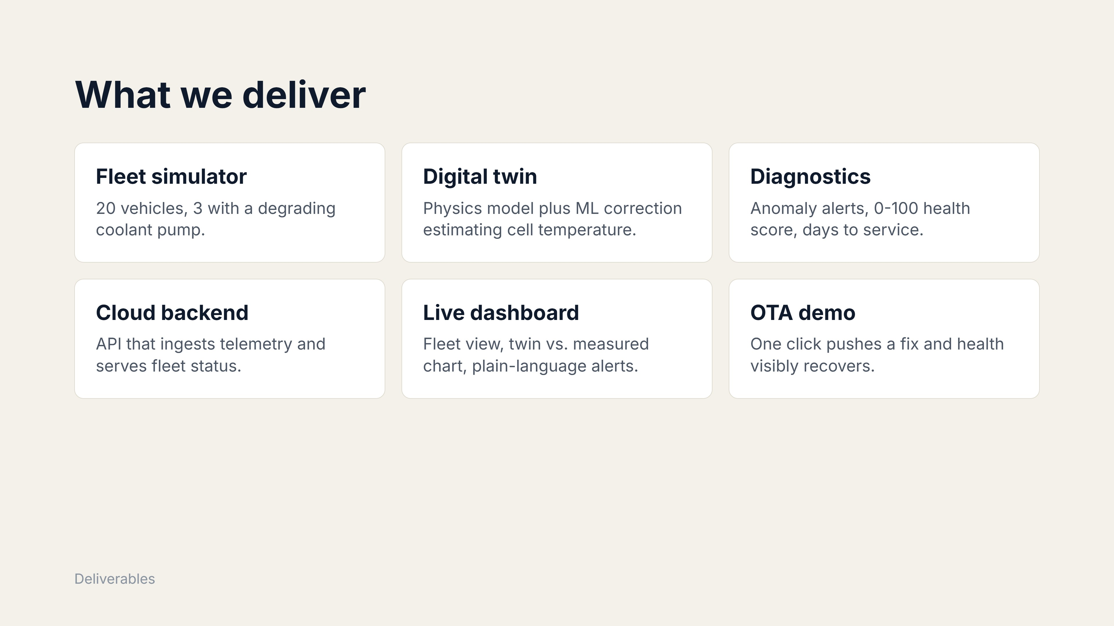
Notes:
Plus architecture diagram, pitch deck and a 3-minute demo.

Slide 8
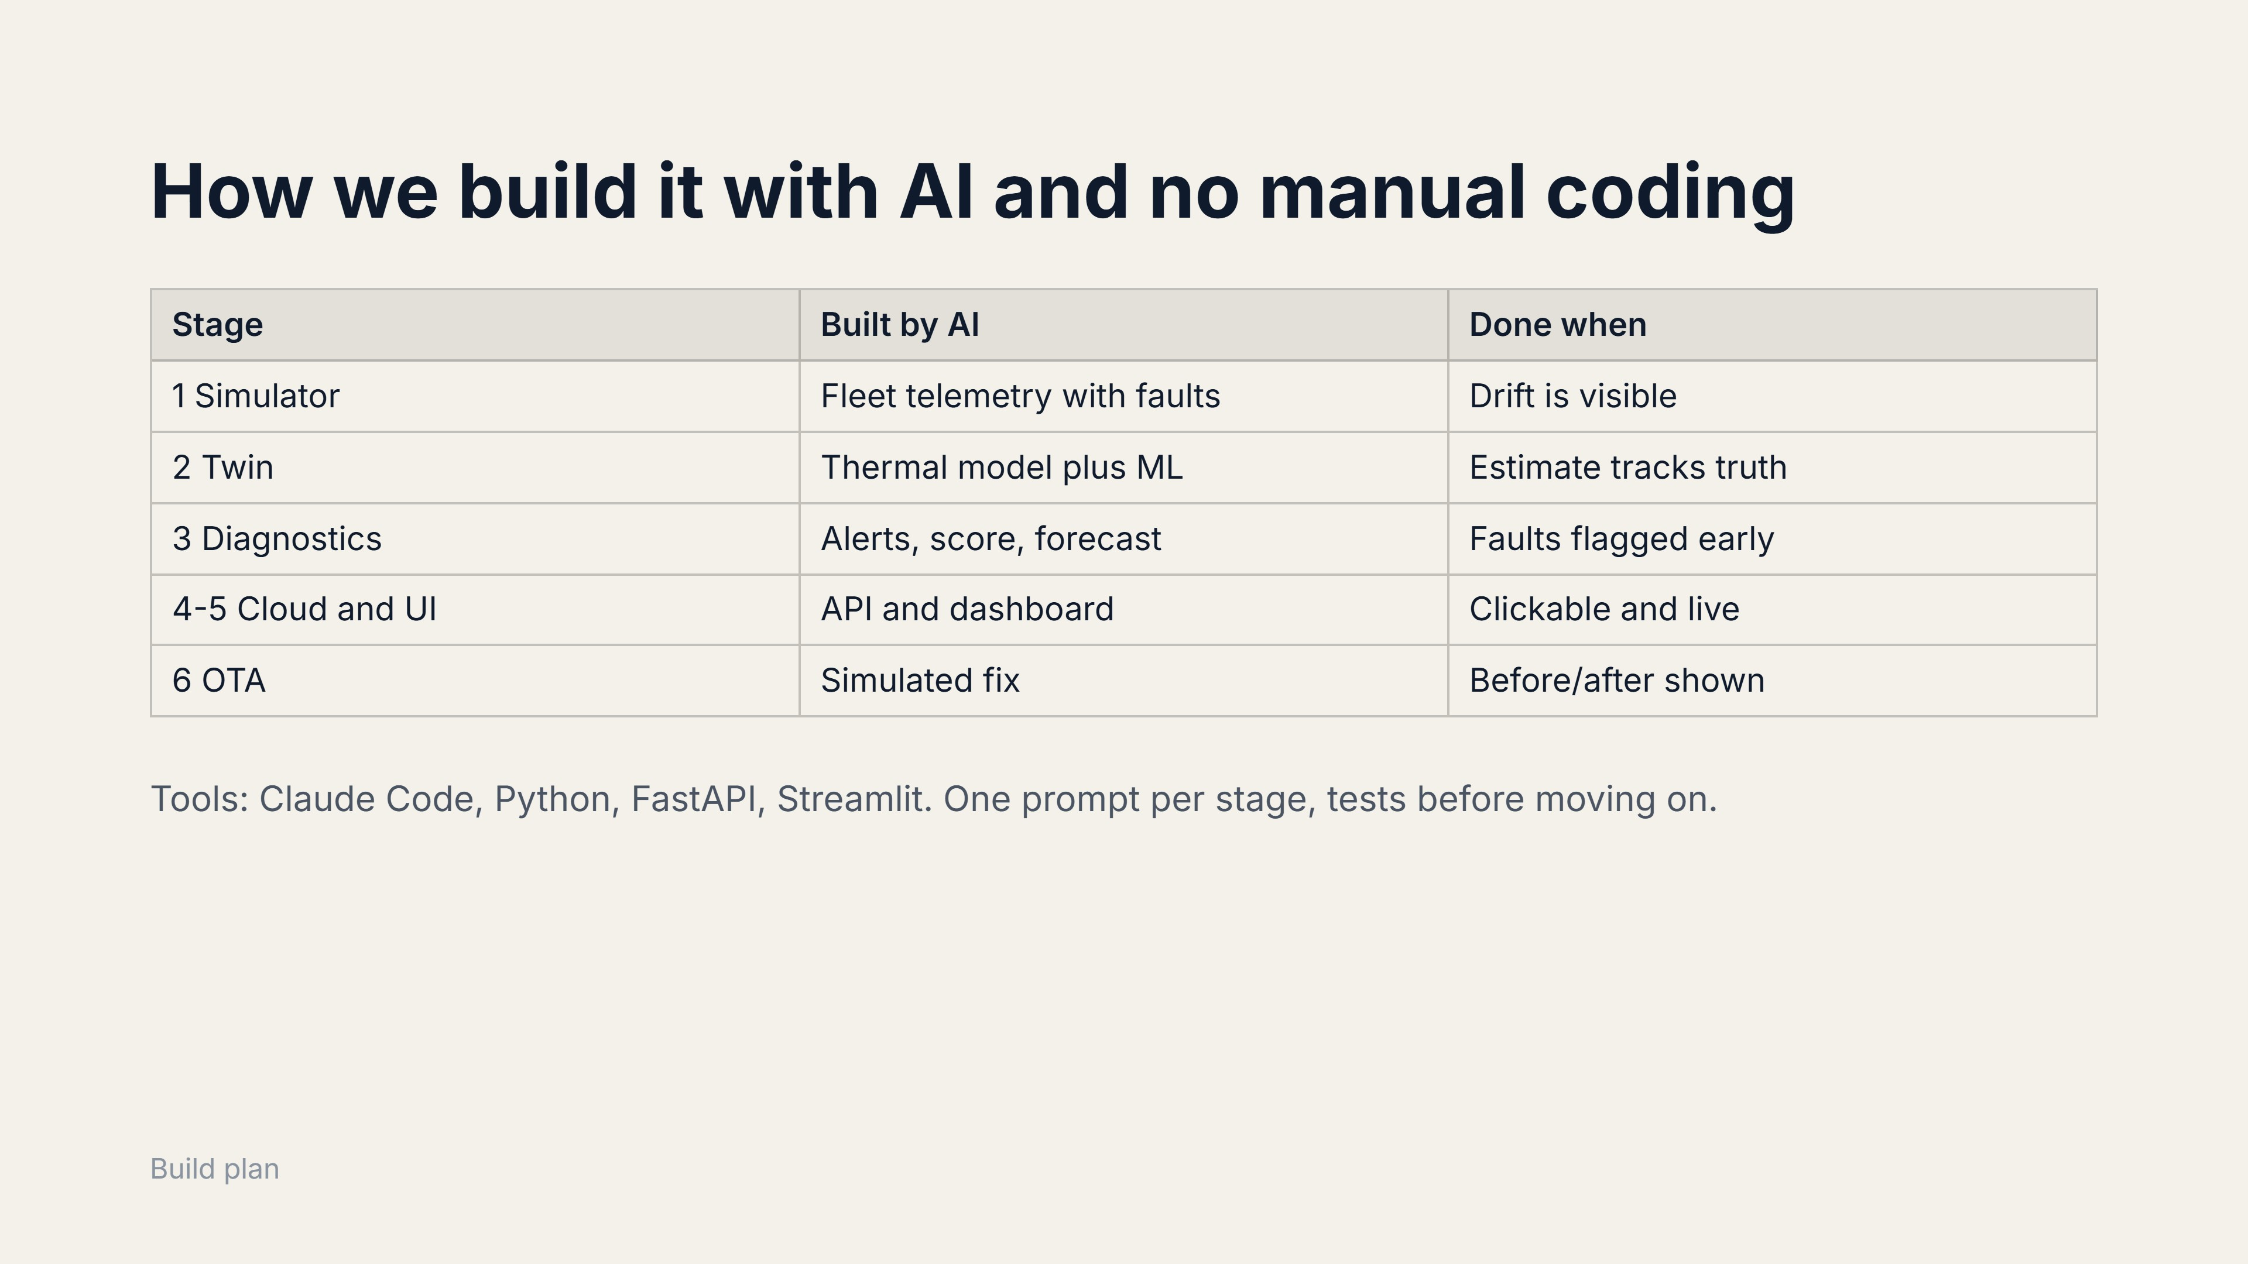
Notes:
Stage 7, nightly retraining, is optional if time allows.

Slide 9
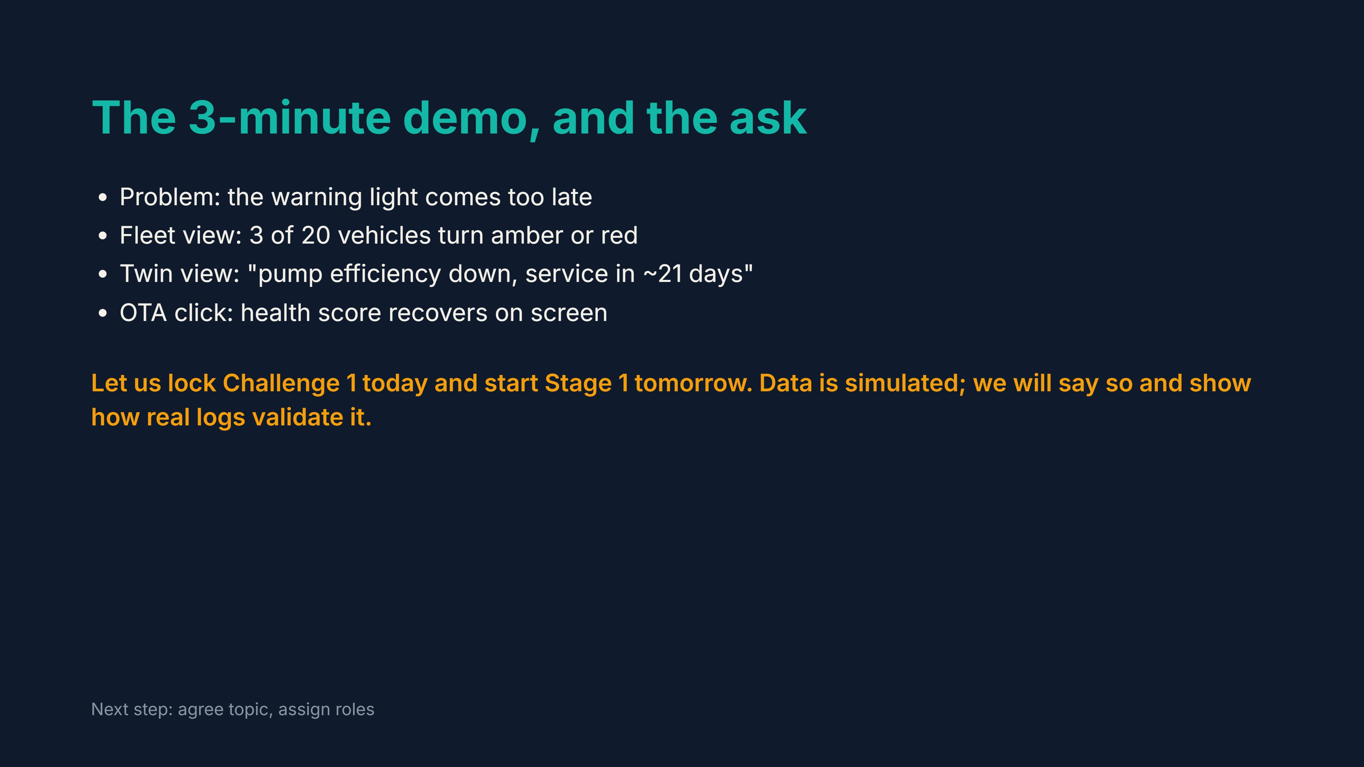
Notes:
End by asking for the team decision.

